Slide 1

An Introduction to

Slide 2
Database Popularity
Rank | Name | Score
1. | Oracle | 1617.19
2. | MySql | 1254.27
3. | SQL Server | 1234.46
4. | PostgreSQL | 190.83
5. | DB2 | 165.9
6. | MongoDB | 161.87
7. | Microsoft Access | 141.6
8. | SQLite | 78.78
9. | Sybase | 77.75
http://db-engines.com/en/ranking

Slide 3
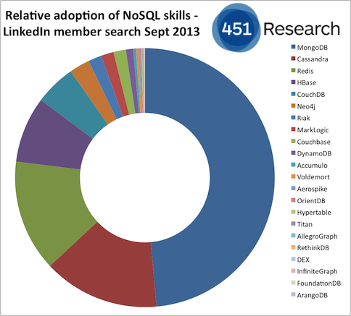

Slide 4
History
2004 - Google BigTable Paper
NoSql becomes mainstream technology
Kicks off movement to create “web scale” databases
2007 - 10Gen releases MongoDB
Bridges gap between key-values and RDBMS
2009 - Open Sourced - GitHub

Slide 5
Support
10Gen -> MongoDB Company
Sells enterprise version
Security and backup tools
Training
Integration
Support
Just raised $150,000,000
Documention - MongoDB.org

Slide 6
Drivers
JavaScript
Python
Ruby
PHP
Perl
Java
Scala
C#
C
C++
Haskell
Erlang
Plus numerous 3rd party tools and libraries!

Slide 7
Major Deployments
Groupon
Craigslist
Bit.ly
eBay
eHarmony
Answers.com (St. Louis)
CarFax (St. Louis)

Slide 8
Primary Benefits
Speed Speed Speed!
Rich Dynamic Queries
Lazy Creation
Schema-less
Returns JSON
Easy Replication and Failover
Auto-Sharding
MapReduce

Slide 9
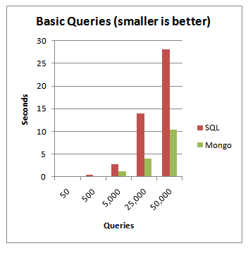
How Fast?

Slide 10
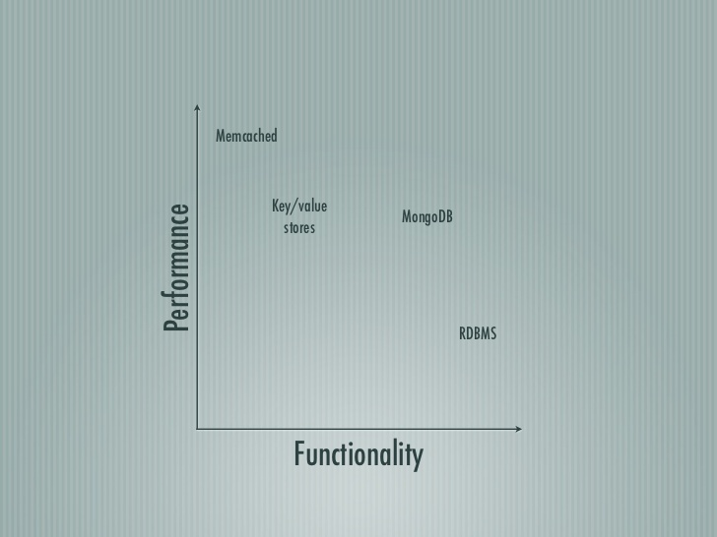

Slide 11
SQL vs Document Databases
SQL databases are considered relational databases. They store related data in separate tables. When data is needed, it is queried from multiple tables to join the data back together.
MongoDB is a document database which is often referred to as a non-relational database. This does not mean that relational data cannot be stored in document databases. It means that relational data is stored differently. A better way to refer to it is as a non-tabular database.
MongoDB stores data in flexible documents. Instead of having multiple tables you can simply keep all of your related data together. This makes reading your data very fast.
You can still have multiple groups of data too. In MongoDB, instead of tables these are called collections.

Slide 12
A BSON (binary JSON) document
{
"_id" : ObjectId("52832eb59f36fe144eeea8dc"),
"baseprice" : 8.99,
"category" : "toys",
"colors" : [ "red", "green", "cosmic purple"],
"name" : "Cosmic Yo-yo",
"promotions" : [
{ "coupon" : "XY678", "saleprice" : 7.99, "expires" : ISODate("2013-12-12T00:00:00Z") },
{ "coupon" : "AB8888", "saleprice" : 7.49, "expires" : ISODate("2014-01-01T00:00:00Z") }
]
}

Slide 13
Terminology
Database -> Database
Table -> Collection
Record / Row -> Document
Field -> Field

Slide 14
find()
db.products.findOne()
db.products.find()
db.products.find().pretty()
db.products.find({ _id : ObjectId("52832eb59f36fe144eeea8dc") })
db.products.find({ name : "Cosmic Yo-yo" })
db.products.find({ name : /^hack/i }).pretty()
Index fields used for find!

Slide 15
Projections
db.products.find({ "name" : "Hacky Sack Maxx" },{ baseprice : 1 } )
db.products.find({ "name": "Hacky Sack Maxx" },{ baseprice: 1, category : 1 } )
db.products.find( { }, { promotions : 1 } )
db.products.find( { }, { promotions : 1 } )[0].promotions

Slide 16
Ids
ObjectId is a 12-byte BSON type, constructed using:
a 4-byte value representing the seconds since the Unix epoch,
a 3-byte machine identifier,
a 2-byte process id, and
a 3-byte counter, starting with a random value
Show with .getTimestamp()

Slide 17
Shell
Runs native JavaScript
Google V8
Can run native functions, but not recommended in production

Slide 18
Queries
db.products.find().sort( { baseprice : -1 }).pretty()
db.products.find().limit(1).pretty()
db.products.find().limit(1).skip(1).pretty()

Slide 19
Conditions
db.products.find({ baseprice : { $gt : 4.99 }})
db.products.find({ baseprice : { $lte : 4.99 }})
db.products.find({ promotions : { $lte : 4.99 }})
db.products.find( { colors : { $in : ["red"] }})
db.products.find( { "promotions.coupon" : { $in : [ "XY678" ] }}).pretty()
db.products.find({ $and : [{ category : "toys"},{ baseprice : { $gt : 4.99 }}]}

Slide 20
Other Queries
db.products.count()
db.products.find({ baseprice : { $gt : 2.99 }}).count()
db.products.insert({ name : "Juggle-O-rama", baseprice : 11.99 })
db.products.update({ name : "Juggle-O-rama" }, { $set : { category : "toys" }})
db.products.update({ name: “Juggle-O-rama” }, { $set : { colors : ["silver", "gold"]}})
db.products.update({ name: "Juggle-O-rama" }, { $push : { colors : "sea foam green"}})
Don’t forget $set!

Slide 21
Aggregation
db.products.aggregate({ $group : { _id : "$category", totalprice : { $sum : "$baseprice" }}})

Slide 22
Indexes
Single
Compound
Nested Elements
In Array
Whole Document!
db.products.ensureIndex({ name : 1})

Slide 23
Geospatial Indexes
{
_id : ObjectId(...), name : "Brad Urani", addresses : [
{ context : "home" , loc : [ 55.5, 42.3 ] }, { context : "office", loc : [ -74 , 44.74 ] } ]
}
Can Query
Within Certain Distance
Within Polygons
Where Polygons Intersect
Others

Slide 24
Index contd…
From the Atlas dashboard, click on your Cluster name then the Search tab.
Click on the Create Search Index button.
Use the Visual Editor and click Next.
Name your index, choose the Database and Collection you want to index and click Next.
If you name your index "default" you will not have to specify the index name in the $search pipeline stage.
Choose the sample_mflix database and the movies collection.
Click Create Search Index and wait for the index to complete.

Slide 25
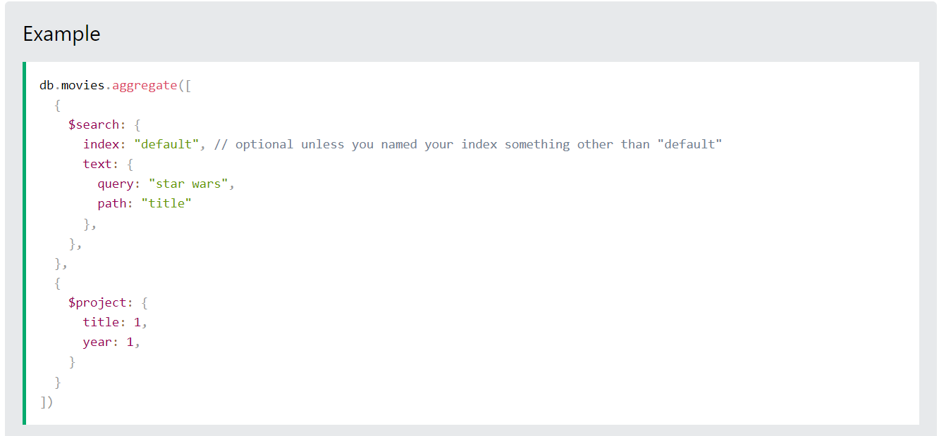
Index contd…

Slide 26
Temporary Records
Time to Live (TTL)
db.log.events.ensureIndex( { "status": 1 }, { expireAfterSeconds: 3600 } )
Capped Collections
Set a maximum number of records in the collection
Provides very fast writing

Slide 27
Primary Benefits
Speed Speed Speed!
Rich Dynamic Queries
Lazy Creation
Flexible Schema
Returns JSON
Easy Replication and Failover
Auto-Sharding
MapReduce

Slide 28
Lazy Creation
Lazy Creation Saves Developer Time
Instant Set-up
No Change Scripts
Easier Data Migration
Great for Data Warehousing

Slide 29
Flexible Schemas
I.E. Different data for different for different product types
Flexible nesting rules
Simplifies Internationalization
Easy Custom Fields

Slide 30
JSON Front-to-Back!
Queries return JSON
Dirt simple APIs
No Data Manipulation Needed
Ditch the ORM
Easy JavaScript Integration
Fits perfectly with KnockoutJS, AngularJS etc.

Slide 31
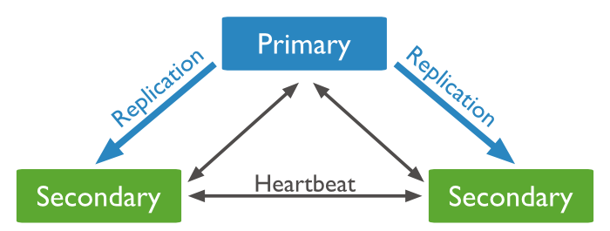
Replica Sets
Master / Slave

Slide 32
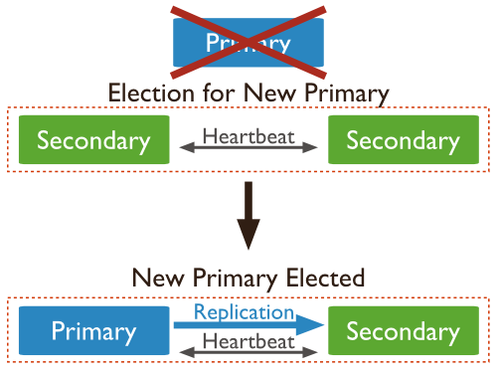
Replica Set Election
If a primary fails, the secondaries automatically elect a new primary

Slide 33
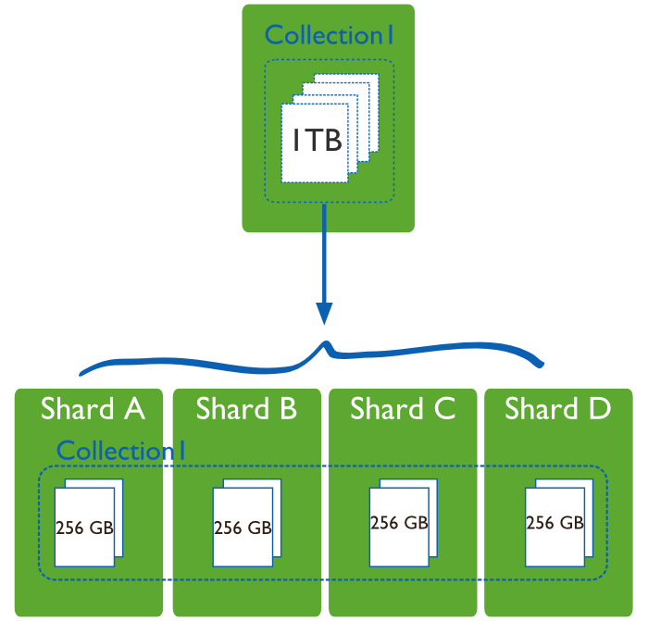
Sharding
Collections are split amongst multiple servers by a shard key
Used to scale writes

Slide 34
Limitations
No Transactions
No Joins
RAM intensive
No referential integrity
Eventual Consistency

Slide 35
Design Considerations
Embed vs. Reference
Instead of joining junction tables, embed subdocuments in documents
90% of the time choose embed over reference
You may have to store the same data twice

Slide 36
Denormalized Data
{
_id : ObjectId(...),
Name: “November Specials”,
Promotions : [
{ Title: “20% off all Yo-yos”, Coupon: “AB345” },
{ Title: “Free shipping on Hacky Sacks”, Coupon : “XY456” }
],
Dates : [ ISODate(“2013-11-01”), ISODate(“2013-11-31) ]
}, { _id : ObjectId(...),
Name: “December Specials”,
Promotions : [
{ Title: “10% off all frisbees”, Coupon: “BA445” },
{ Title: “Free overnight shipping on all jump ropes”, Coupon : “XY456” }

Slide 37
Schema Design
SQL: Optimizing how data is stored
MongoDB: Optimize how data is used
SQL: What answers do I have?
MongoDB: What questions do I have?

Slide 38
Choices
{
OrderId(“....”)
Items : [
{ _id : ObjectId(“...”), name : “Cosmic Yo-yo”, color : “red”, qty : 1 },
{ _id : ObjectId(“...”), name : Hackey Sack Maxx”, color : “tiger orange”, qty: 2 }
]
Promotions : [
{ _id : ObjectId(“...”), Coupon : “AB456” : 6.99 }
]
}

Slide 39
Use Cases
Anything with user generated data
Social Media
CMS
Blogs
Product Data (Ecommerce)
Games
Location services
Logging
Clickstream
Analytics
Real-Time
Data Warehouses

Slide 40
Not Great For
Transaction Critical Data
Purchases
Banking
Inventory Control

Slide 41
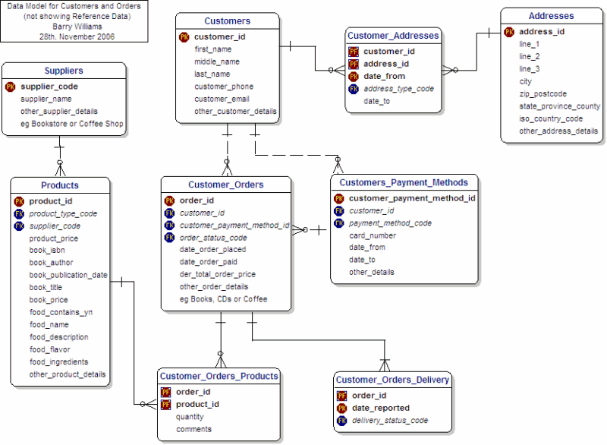
Use Both!
Products in MongoDB
Orders in SQL
{
"_id" : ObjectId("52833435add826d9da839268"),
"baseprice" : 4.99,
"category" : "toys",
"colors" : [ "tiger orange", " canary yellow" ],
"name" : "Hacky Sack Maxx",
"promotions" : [ { "coupon" : "ZY678", "saleprice" : 4.49, "expires" 13-12-12T00:00:00Z") },
{ "coupon" : "CD8888", "promo" : "free shipping", "expires"
]
}

Slide 42
Architect for Scalability
Databases need to handle peak load, not average load
Avoid Unnecessary Data Transformations
Developer productivity is part of scalability

